Slide 1
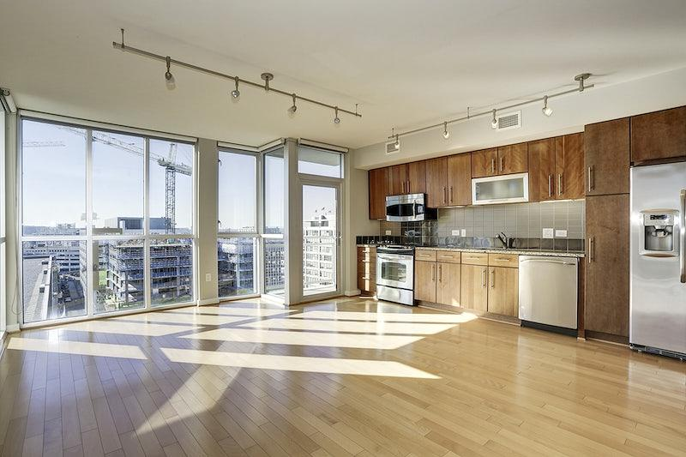

House Prices Prediction
Decoding rental prices in CT
Notes:
For project title

Slide 2

Table of Contents:
Meet our Team
Problem Statement
Solution
Project Pipeline
Technology Deployed
CT Rental Trend

Slide 3

Meet Our Team
Abhishek Kukreja
Vaishnavi Malapati Sai
Srijani Challagundla
Sai
Sai Deekshith Miyapuram
Omkar Avinash
Notes:
Project members

Slide 4

Problem Statement
UNH attracts international students every year finding an apartment in a new country becomes an arduous task
Rental amount comes with an added burden on a student's wallet therefore students can plan their expenses if they know the rental property prices in nearby counties
We are trying to decode the rental property prices on the CT basis of each county
UNH attracts international students every year and finding an apartment in a new country becomes an arduous task
Rental amount comes with an added burden on a student's wallet therefore students can plan their expenses if they know the rental property prices in nearby counties
We are trying to decode the rental property prices on the CT basis of each county
Problem Statement
What are we trying to solve?
Notes:
Problem Statement
We also aim to make the model robust by deploying it on a website and giving the end user options to control the apartment settings based on their need e.g. number of bedrooms, distance from the University, transportation availability etc.

Slide 5

A house price dataset from kaggle will be used to build a machine learning model that predicts house prices
Features such as number of bedrooms, bathrooms, overall square footage, etc will be used to create the model
Python numpy and pandas libraries will allow us to clean and prepare the data for modeling
A end-to-end web development will provide users home price predictions
How are we solving it?
Notes:
Solutions

Slide 6
Project Pipeline
Data processing elements involved in the project
Data Extraction and Cleaning
Feature Engineering
Outlier Removal
Model Building
Model Deployment
Scraping Zillow data into Google Sheets using API
Data cleaning using Python Libraries
Transforming the data to better represent the underlying problem
Adding features to reduce multicollinearity
Performing EDA to identify the data outliers
Performing outlier treatment e.g.using quartiles
Building the model using linear regression in sklearn
Using Python flask server to serve https request
Website that allow users to enter attributes and retrieve the predicted price
Notes:
Data pipeline

Slide 7


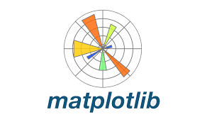



Technology Deployed
How are we achieving it?
Python libraries such as pandas and numpy will be used for data processing
Python libraries such as matplotlib and seaborn will be used to visualize the data
Python libraries such as sklearn will be used to predict and build models
Java Script will be used to display the model over the web
Python flask will be used to deploy the model over the web
Notes:
Technology deployment

Slide 8

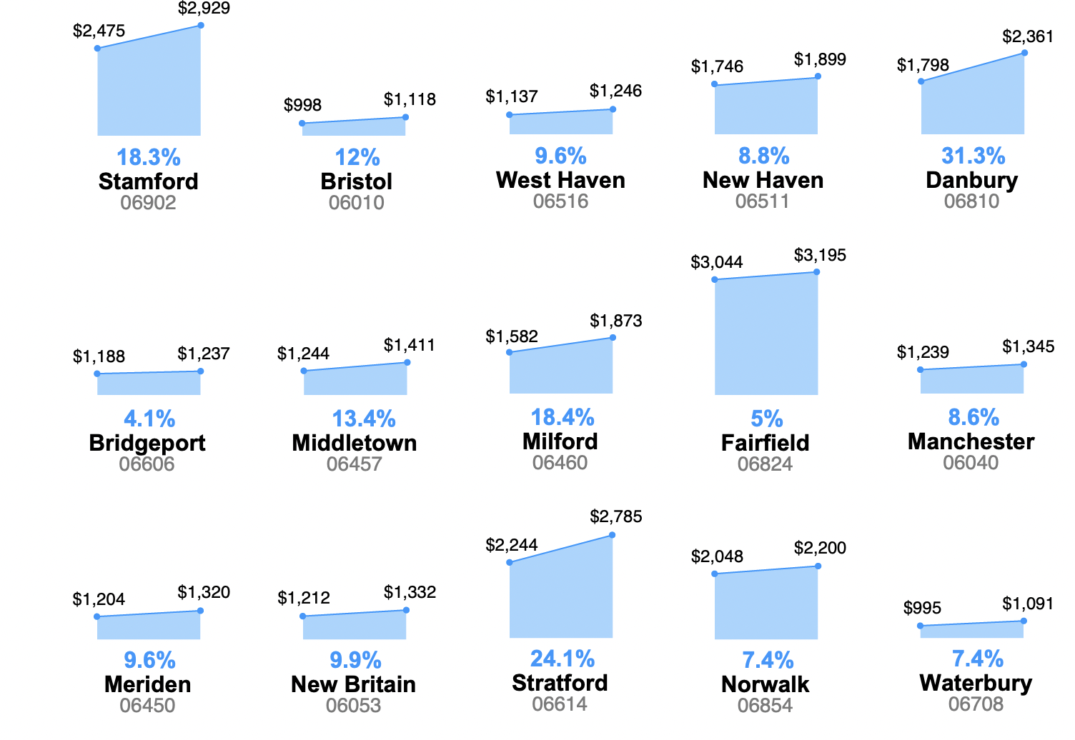
CT Rental Market Research
What is the market trend?
2020 vs 2022

Slide 9


Thank You…
https://github.com/UNH-FantasticFive

